Slide 1
Landslides
Lesson 3: Landslide Preparedness

Slide 2
When Nature Strikes
Why is studying and creating models of landslides important to humans?
https://www.youtube.com/watch?v=dj44dpr8oHs

Slide 3
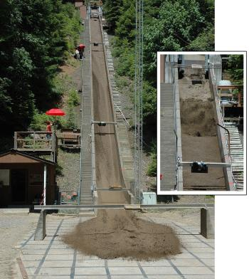
Landslide Factors
Student Concept Sketch
What conditions exist in our own community that might lead to a landslide?

Slide 4
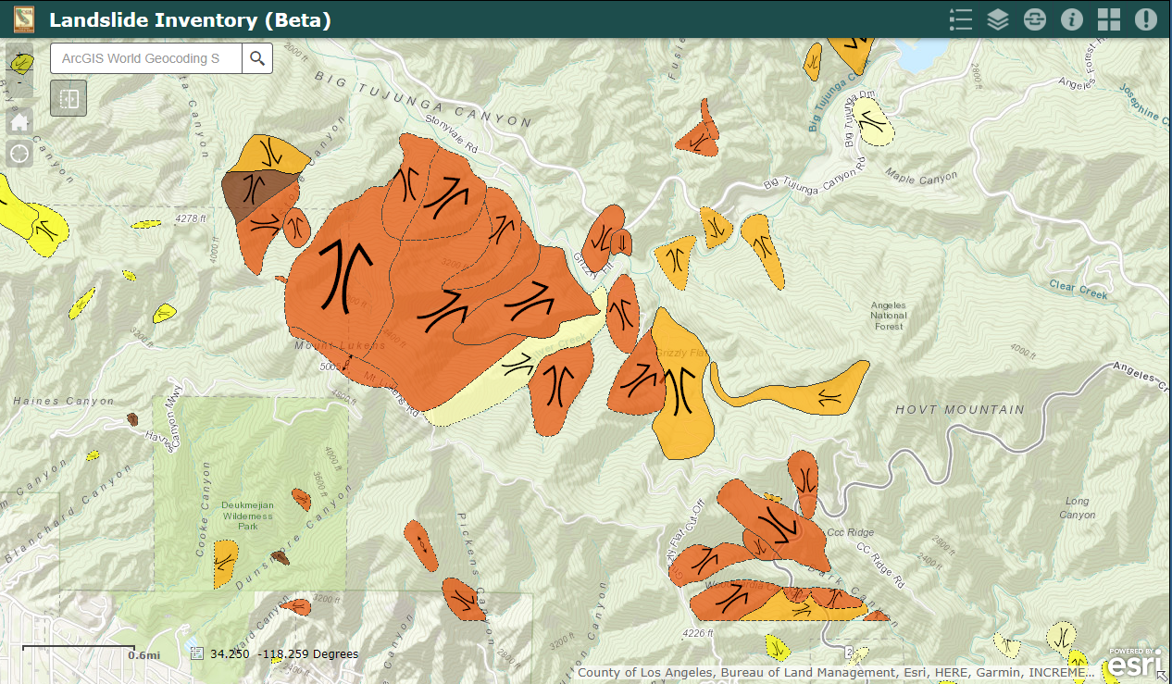
Explore the Landslide Inventory Map

Slide 5
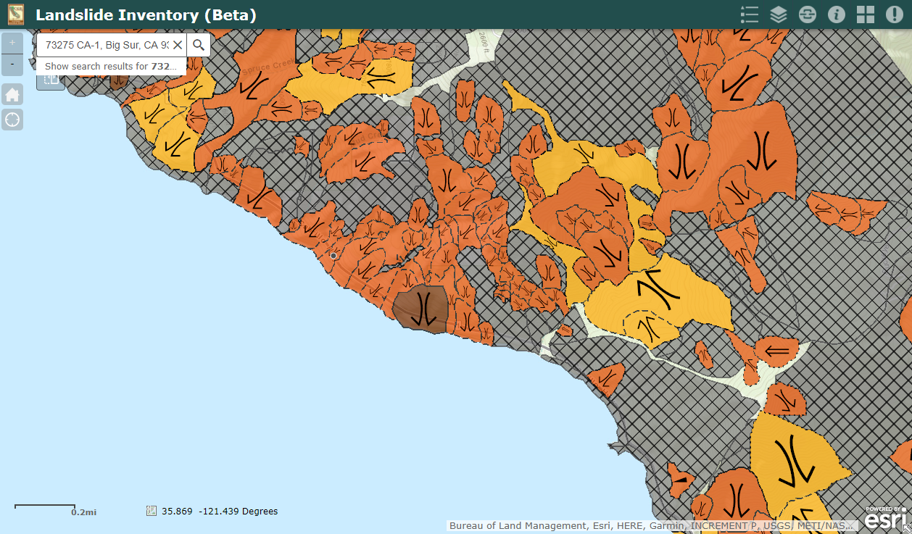

Slide 6
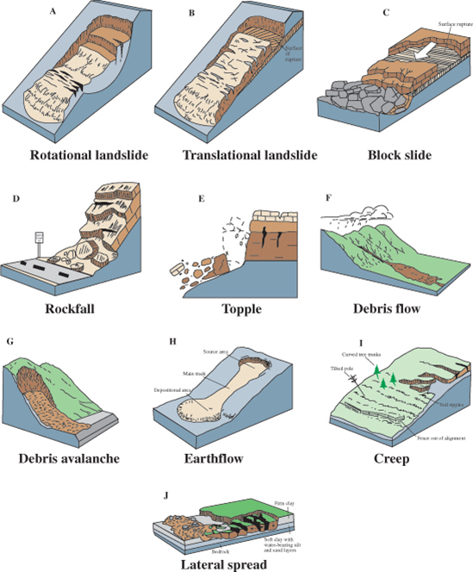
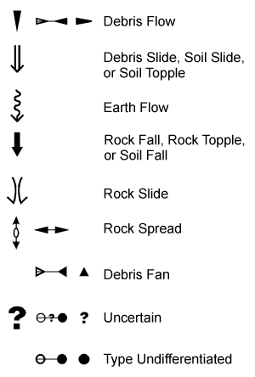
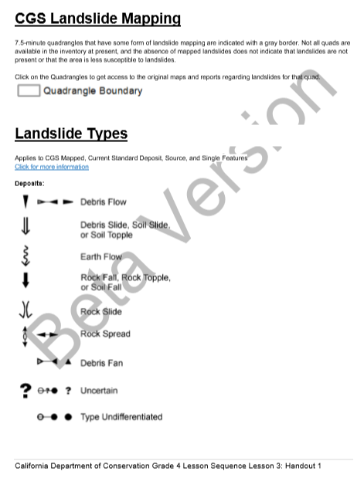
Landslide Types

Slide 7
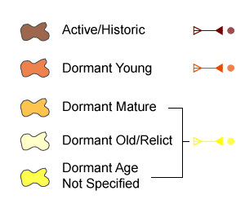
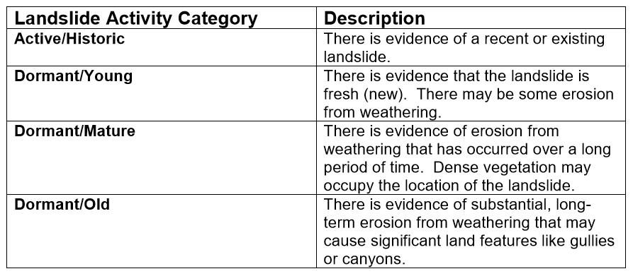
Landslide Ages

Slide 8
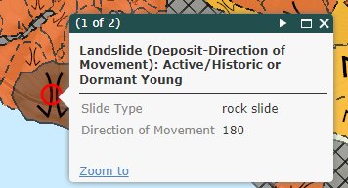

Slide 9
Identify the nearest landslide threat.
Identify the landslide type, activity, and confidence.

Slide 10
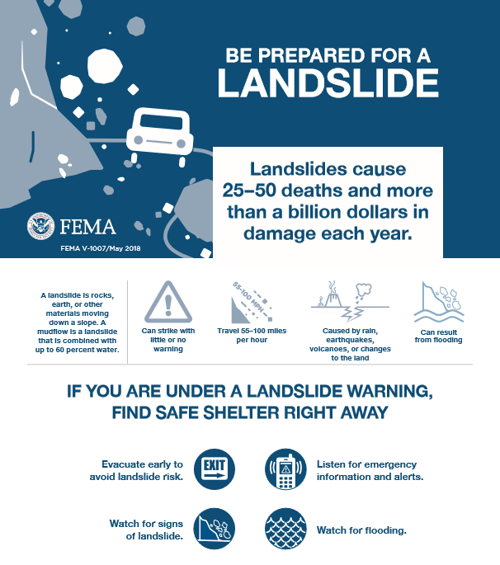
Landslide Communication Strategy

Slide 11
Public Safety Announcement Showcase Components
Definition of a Landslide
Landslide Causes
Types of Landslide
Identifying Landslide Location
Landslide Preparedness

Slide 12
THANK YOU
Questions?

